Slide 1
Tableau dashboard 4,5
File created on: 06-08-2021 00:25:49

Slide 2
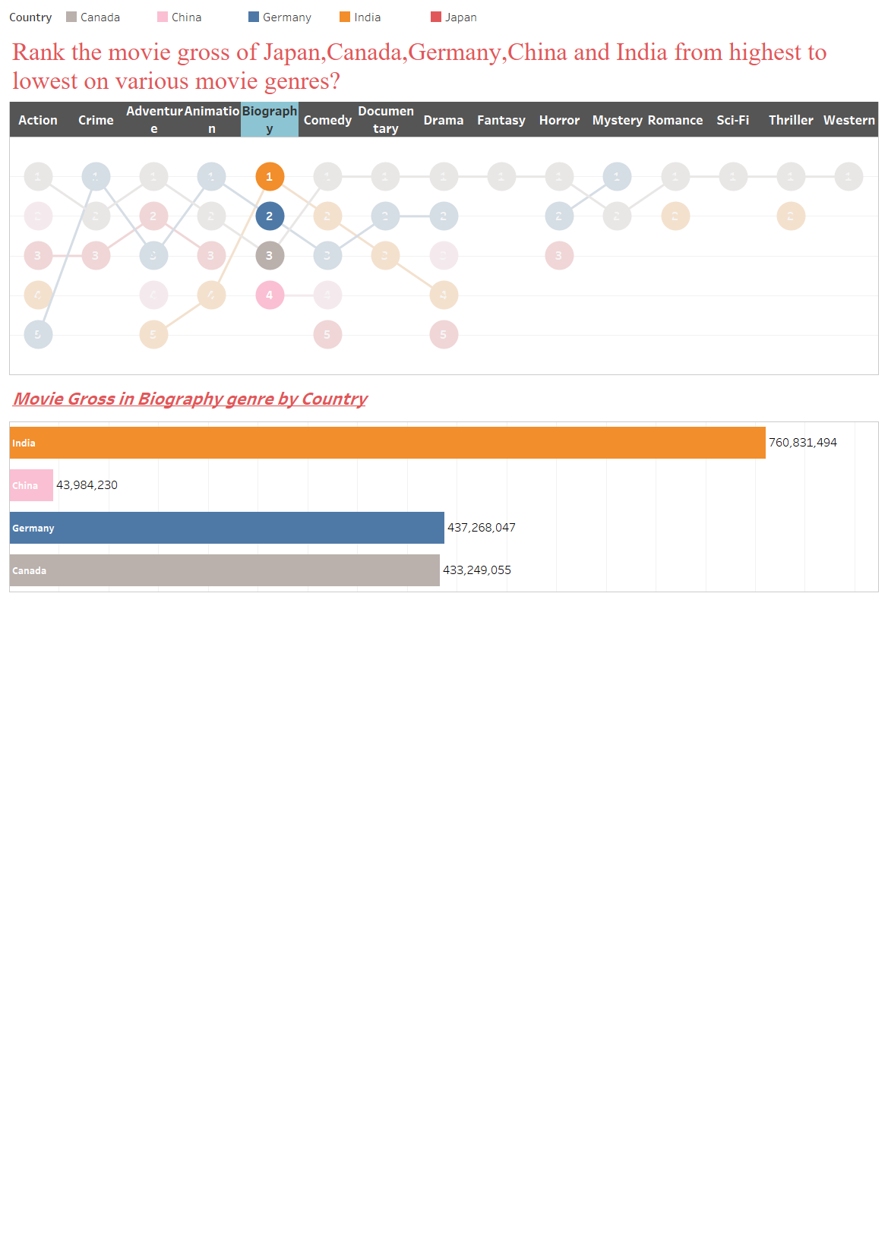

Slide 3
